Slide 1
RUSTikales Rust for beginners
©Philippe Felix Haupt 2023

Slide 2
Plan for today
©Philippe Felix Haupt 2023

Slide 3
Plan for today
Recap
©Philippe Felix Haupt 2023

Slide 4
Plan for today
Recap
Basic types
©Philippe Felix Haupt 2023

Slide 5
Plan for today
Recap
Basic types
integer types → i32, u32, …
©Philippe Felix Haupt 2023

Slide 6
Plan for today
Recap
Basic types
integer types → i32, u32, …
Variables
©Philippe Felix Haupt 2023

Slide 7
Plan for today
Recap
Basic types
integer types → i32, u32, …
Variables
`let` vs `let mut`
©Philippe Felix Haupt 2023

Slide 8
Plan for today
Recap
Basic types
integer types → i32, u32, …
Variables
`let` vs `let mut`
Type Inference
©Philippe Felix Haupt 2023

Slide 9
0. Recap
©Philippe Felix Haupt 2023

Slide 10
0. Recap
cargo init <name> creates a new rust project in directory <name>
©Philippe Felix Haupt 2023

Slide 11
0. Recap
cargo init <name> creates a new rust project in directory <name>
cd <name> to navigate into that directory
©Philippe Felix Haupt 2023

Slide 12
0. Recap
cargo init <name> creates a new rust project in directory <name>
cd <name> to navigate into that directory
cargo creates the following structure:
directory /src/:
contains all your Rust files, cargo prepares a simple “Hello, world!” program
Cargo.toml ← We’ll cover that later
Cargo.lock ← Auto-generated by cargo, we can safely ignore it
©Philippe Felix Haupt 2023

Slide 13
0. Recap
cargo init <name> creates a new rust project in directory <name>
cd <name> to navigate into that directory
cargo creates the following structure:
directory /src/:
contains all your Rust files, cargo prepares a simple “Hello, world!” program
Cargo.toml ← We’ll cover that later
Cargo.lock ← Auto-generated by cargo, we can safely ignore it
cargo build to build your project:
generates an executable, can be found in directory /target/
©Philippe Felix Haupt 2023

Slide 14
0. Recap
cargo init <name> creates a new rust project in directory <name>
cd <name> to navigate into that directory
cargo creates the following structure:
directory /src/:
contains all your Rust files, cargo prepares a simple “Hello, world!” program
Cargo.toml ← We’ll cover that later
Cargo.lock ← Auto-generated by cargo, we can safely ignore it
cargo build to build your project:
generates an executable, can be found in directory /target/
cargo run to build and run your project
©Philippe Felix Haupt 2023

Slide 15
0. Recap
cargo init <name> creates a new rust project in directory <name>
cd <name> to navigate into that directory
cargo creates the following structure:
directory /src/:
contains all your Rust files, cargo prepares a simple “Hello, world!” program
Cargo.toml ← We’ll cover that later
Cargo.lock ← Auto-generated by cargo, we can safely ignore it
cargo build to build your project:
generates an executable, can be found in directory /target/
cargo run to build and run your project
rust-analyzer is a very helpful tool for programming in Rust
©Philippe Felix Haupt 2023

Slide 16
Basic types
©Philippe Felix Haupt 2023

Slide 17
Basic types
Rust is a statically typed language
©Philippe Felix Haupt 2023

Slide 18
Basic types
Rust is a statically typed language
Every variable has exactly one known type
©Philippe Felix Haupt 2023

Slide 19
Basic types
Rust is a statically typed language
Every variable has exactly one known type
You can’t change that type
©Philippe Felix Haupt 2023

Slide 20
Basic types
Rust is a statically typed language
Every variable has exactly one known type
You can’t change that type
The compiler statically type checks your code
©Philippe Felix Haupt 2023

Slide 21
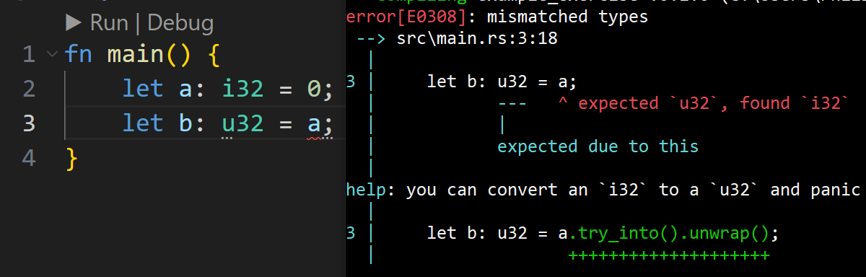
Basic types
Rust is a statically typed language
Every variable has exactly one known type
You can’t change that type
The compiler statically type checks your code
Finds type errors, like:
assigning an `i32` to an `u32`
©Philippe Felix Haupt 2023

Slide 22
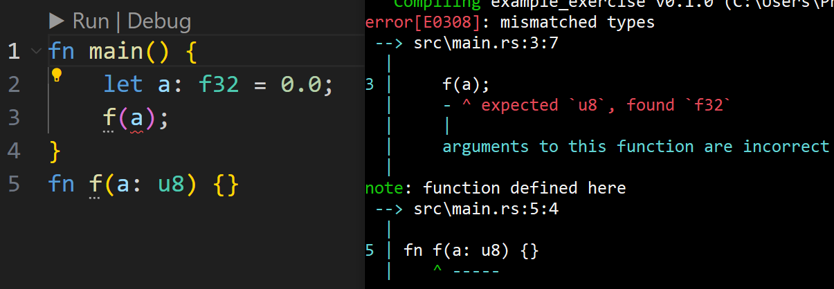
Basic types
Rust is a statically typed language
Every variable has exactly one known type
You can’t change that type
The compiler statically type checks your code
Finds type errors, like:
assigning an `i32` to an `u32`
passing an `f32` as an argument, where `u8` was expected
©Philippe Felix Haupt 2023

Slide 23
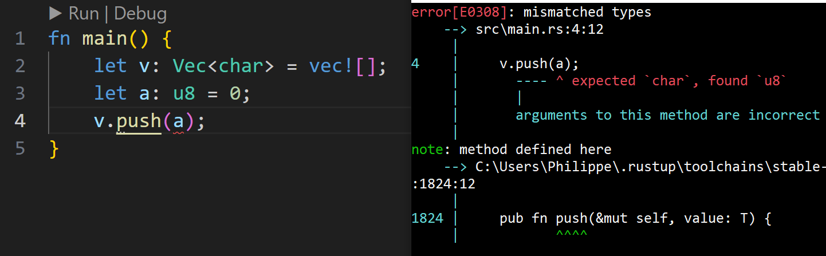
Basic types
Rust is a statically typed language
Every variable has exactly one known type
You can’t change that type
The compiler statically type checks your code
Finds type errors, like:
assigning an `i32` to an `u32`
passing an `f32` as an argument, where `u8` was expected
pushing a `u8` to a `Vec<char>`
©Philippe Felix Haupt 2023

Slide 24
Basic types
Rust is a statically typed language
Every variable has exactly one known type
You can’t change that type
The compiler statically type checks your code
Finds type errors, like:
assigning an `i32` to an `u32`
passing an `f32` as an argument, where `u8` was expected
pushing a `u8` to a `Vec<char>`
Very useful, because you never need to worry about what may be the type of your variable
It’s always known, and not changeable
Contrast to variables in dynamic languages like Python, where you can assign any value to any variable at any point
©Philippe Felix Haupt 2023

Slide 25
Basic types
Rust has different types:
Scalar types: Represent a single value
©Philippe Felix Haupt 2023

Slide 26
Basic types
Rust has different types:
Scalar types: Represent a single value
integer
whole numbers, either signed or unsigned
floating point
“scientific notation in base 2” (fractions and big numbers)
boolean
either true or false
character
Unicode Values
©Philippe Felix Haupt 2023

Slide 27
Basic types
Rust has different types:
Scalar types: Represent a single value
integer
whole numbers, either signed or unsigned
floating point
“scientific notation in base 2” (fractions and big numbers)
boolean
either true or false
character
Unicode Values
Compound types: Combinations of scalar and compound types
©Philippe Felix Haupt 2023

Slide 28
Basic types
Rust has different types:
Scalar types: Represent a single value
integer
whole numbers, either signed or unsigned
floating point
“scientific notation in base 2” (fractions and big numbers)
boolean
either true or false
character
Unicode Values
Compound types: Combinations of scalar and compound types
array → fixed length collection of values of the same type
tuple → fixed length collection of values of (possibly) different types
struct → User-defined collections of values
©Philippe Felix Haupt 2023

Slide 29
Basic types
Rust has different types:
Scalar types: Represent a single value
integer
whole numbers, either signed or unsigned
floating point
“scientific notation in base 2” (fractions and big numbers)
boolean
either true or false
character
Unicode Values
Compound types: Combinations of scalar and compound types
array → fixed length collection of values of the same type
tuple → fixed length collection of values of (possibly) different types
struct → User-defined collections of values
We’ll only be covering scalar types, specifically integers today!
©Philippe Felix Haupt 2023

Slide 30
Basic types - Integers
Rust has clear names for integer types
©Philippe Felix Haupt 2023

Slide 31
Basic types - Integers
Rust has clear names for integer types
Type | Meaning | Min Value | Max Value
i8 | signed 8 bit integer | -(2^7) = -128 | 2^7-1 = 127
u8 | unsigned 8 bit integer | 0 | 2^8-1 = 255
i16 | signed 16 bit integer | -(2^15) = -65536 | 2^15-1 = 65535
u16 | unsigned 16 bit integer | 0 | 2^16-1
i32 | signed 32 bit integer | -(2^31) | 2^31-1
u32 | unsigned 32 bit integer | 0 | 2^32
i64 / i128 | … | … | …
u64 / u128 | … | … | …
©Philippe Felix Haupt 2023

Slide 32
Basic types - Integers
Compared to `unsigned long long int` or `short`, you never need to remember sizes
Rust has clear names for integer types
Type | Meaning | Min Value | Max Value
i8 | signed 8 bit integer | -(2^7) = -128 | 2^7-1 = 127
u8 | unsigned 8 bit integer | 0 | 2^8-1 = 255
i16 | signed 16 bit integer | -(2^15) = -65536 | 2^15-1 = 65535
u16 | unsigned 16 bit integer | 0 | 2^16-1
i32 | signed 32 bit integer | -(2^31) | 2^31-1
u32 | unsigned 32 bit integer | 0 | 2^32
i64 / i128 | … | … | …
u64 / u128 | … | … | …
©Philippe Felix Haupt 2023

Slide 33
Basic types - Integers
Compared to `unsigned long long int` or `short`, you never need to remember sizes
Rust has clear names for integer types
Type | Meaning | Min Value | Max Value
i8 | signed 8 bit integer | -(2^7) = -128 | 2^7-1 = 127
u8 | unsigned 8 bit integer | 0 | 2^8-1 = 255
i16 | signed 16 bit integer | -(2^15) = -65536 | 2^15-1 = 65535
u16 | unsigned 16 bit integer | 0 | 2^16-1
i32 | signed 32 bit integer | -(2^31) | 2^31-1
u32 | unsigned 32 bit integer | 0 | 2^32
i64 / i128 | … | … | …
u64 / u128 | … | … | …
16 bit
128 bit
©Philippe Felix Haupt 2023

Slide 34
Basic types - Integers
Rust has clear names for integer types
You rarely need anything besides 8bit, 32bit and 64bit integers
©Philippe Felix Haupt 2023

Slide 35
Basic types - Integers
Rust has clear names for integer types
You rarely need anything besides 8bit, 32bit and 64bit integers
Rust also has types `isize` and `usize`
Target machine dependent size
On a 64 bit machine, it’s 64 bit
On a 32 bit machine, it’s 32 bit
©Philippe Felix Haupt 2023

Slide 36
Basic types - Integers
Rust has clear names for integer types
You rarely need anything besides 8bit, 32bit and 64bit integers
Rust also has types `isize` and `usize`
Target machine dependent size
On a 64 bit machine, it’s 64 bit
On a 32 bit machine, it’s 32 bit
Does anyone know why?
3/3
©Philippe Felix Haupt 2023

Slide 37
Basic types - Integers
Rust has clear names for integer types
You rarely need anything besides 8bit, 32bit and 64bit integers
Rust also has types `isize` and `usize`
Target machine dependent size
On a 64 bit machine, it’s 64 bit
On a 32 bit machine, it’s 32 bit
Does anyone know why?
Used for indexing, sizes, offsets
Everything involving pointer arithmetics
Pointers are always as big as the computer supports, so `isize` and `usize` must be flexible
3/3
©Philippe Felix Haupt 2023

Slide 38
Basic types - Integers
Rust has clear names for integer types
You rarely need anything besides 8bit, 32bit and 64bit integers
Rust also has types `isize` and `usize`
Target machine dependent size
On a 64 bit machine, it’s 64 bit
On a 32 bit machine, it’s 32 bit
Does anyone know why?
Used for indexing, sizes, offsets
Everything involving pointer arithmetics
Pointers are always as big as the computer supports, so `isize` and `usize` must be flexible
`usize` being used for pointers may sound scary, but we’ll not be doing anything with pointers*
3/3
©Philippe Felix Haupt 2023

Slide 39
Basic types - Integers
Rust has clear names for integer types
You rarely need anything besides 8bit, 32bit and 64bit integers
Rust also has types `isize` and `usize`
Target machine dependent size
On a 64 bit machine, it’s 64 bit
On a 32 bit machine, it’s 32 bit
Does anyone know why?
Used for indexing, sizes, offsets
Everything involving pointer arithmetics
Pointers are always as big as the computer supports, so `isize` and `usize` must be flexible
`usize` being used for pointers may sound scary, but we’ll not be doing anything with pointers*
if you want to index into an array, vector… your index needs to be of type `usize`
3/3
©Philippe Felix Haupt 2023

Slide 40
2. Variables
Having integers is nice and all, but can we also assign them to variables for later use?
©Philippe Felix Haupt 2023

Slide 41
2. Variables
Having integers is nice and all, but can we also assign them to variables for later use?
Of course we can, that’s the basis of programming!
©Philippe Felix Haupt 2023

Slide 42
2. Variables
Having integers is nice and all, but can we also assign them to variables for later use?
Of course we can, that’s the basis of programming!
Rust is special, has many ways of declaring a variable:
©Philippe Felix Haupt 2023

Slide 43
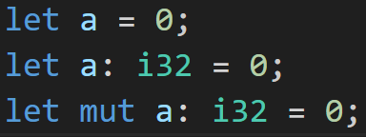
2. Variables
Having integers is nice and all, but can we also assign them to variables for later use?
Of course we can, that’s the basis of programming!
Rust is special, has many ways of declaring a variable:
©Philippe Felix Haupt 2023

Slide 44
2. Variables
Having integers is nice and all, but can we also assign them to variables for later use?
Of course we can, that’s the basis of programming!
Rust is special, has many ways of declaring a variable:
Let the compiler figure out the type
©Philippe Felix Haupt 2023

Slide 45
2. Variables
Having integers is nice and all, but can we also assign them to variables for later use?
Of course we can, that’s the basis of programming!
Rust is special, has many ways of declaring a variable:
Let the compiler figure out the type
Immutable variable `a` of type `i32`
©Philippe Felix Haupt 2023

Slide 46
2. Variables
Having integers is nice and all, but can we also assign them to variables for later use?
Of course we can, that’s the basis of programming!
Rust is special, has many ways of declaring a variable:
Let the compiler figure out the type
Immutable variable `a` of type `i32`
Mutable variable `a` of type `i32`
©Philippe Felix Haupt 2023

Slide 47
2. Variables
Having integers is nice and all, but can we also assign them to variables for later use?
Of course we can, that’s the basis of programming!
Rust is special, has many ways of declaring a variable:
First case: Type Inference → We’ll cover that later
Let the compiler figure out the type
Immutable variable `a` of type `i32`
Mutable variable `a` of type `i32`
©Philippe Felix Haupt 2023

Slide 48
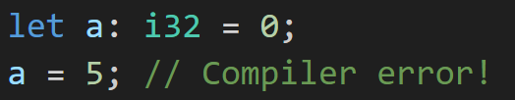
2. Variables
Having integers is nice and all, but can we also assign them to variables for later use?
Of course we can, that’s the basis of programming!
Rust is special, has many ways of declaring a variable:
First case: Type Inference → We’ll cover that later
Second case: `a` is immutable, which means you can’t re-assign to it!
Let the compiler figure out the type
Immutable variable `a` of type `i32`
Mutable variable `a` of type `i32`
©Philippe Felix Haupt 2023

Slide 49

2. Variables
Having integers is nice and all, but can we also assign them to variables for later use?
Of course we can, that’s the basis of programming!
Rust is special, has many ways of declaring a variable:
First case: Type Inference → We’ll cover that later
Second case: `a` is immutable, which means you can’t re-assign to it!
Third case: `a` is mutable, which means you can re-assign to it
Let the compiler figure out the type
Immutable variable `a` of type `i32`
Mutable variable `a` of type `i32`
©Philippe Felix Haupt 2023

Slide 50
2. Variables
There are also other ways of specifying variable modifications:
const → evaluate expression at compile time
static → Basically global variables
but we’ll stay with let for now
©Philippe Felix Haupt 2023

Slide 51
2. Variables
There are also other ways of specifying variable modifications:
const → evaluate expression at compile time
static → Basically global variables
but we’ll stay with let for now
Why does Rust have that system? What do we gain from making variables immutable?
3/3
©Philippe Felix Haupt 2023

Slide 52
2. Variables
There are also other ways of specifying variable modifications:
const → evaluate expression at compile time
static → Basically global variables
but we’ll stay with let for now
Why does Rust have that system? What do we gain from making variables immutable?
Easier to reason your code, make it explicit what you’re expecting to change
3/3
©Philippe Felix Haupt 2023

Slide 53
2. Variables
There are also other ways of specifying variable modifications:
const → evaluate expression at compile time
static → Basically global variables
but we’ll stay with let for now
Why does Rust have that system? What do we gain from making variables immutable?
Easier to reason your code, make it explicit what you’re expecting to change
Very useful when we come to references and the borrow checker
3/3
©Philippe Felix Haupt 2023

Slide 54
2. Variables
There are also other ways of specifying variable modifications:
const → evaluate expression at compile time
static → Basically global variables
but we’ll stay with let for now
Why does Rust have that system? What do we gain from making variables immutable?
Easier to reason your code, make it explicit what you’re expecting to change
Very useful when we come to references and the borrow checker
Prevents a lot of bugs and oversights
3/3
©Philippe Felix Haupt 2023

Slide 55
2. Variables
There are also other ways of specifying variable modifications:
const → evaluate expression at compile time
static → Basically global variables
but we’ll stay with let for now
Why does Rust have that system? What do we gain from making variables immutable?
Easier to reason your code, make it explicit what you’re expecting to change
Very useful when we come to references and the borrow checker
Prevents a lot of bugs and oversights
TLDR: More control over what is happening
3/3
©Philippe Felix Haupt 2023

Slide 56
2. Variables
There are also other ways of specifying variable modifications:
const → evaluate expression at compile time
static → Basically global variables
but we’ll stay with let for now
Why does Rust have that system? What do we gain from making variables immutable?
Easier to reason your code, make it explicit what you’re expecting to change
Very useful when we come to references and the borrow checker
Prevents a lot of bugs and oversights
TLDR: More control over what is happening
Two things can happen when you assign a variable to another variable:
3/3
©Philippe Felix Haupt 2023

Slide 57
2. Variables
There are also other ways of specifying variable modifications:
const → evaluate expression at compile time
static → Basically global variables
but we’ll stay with let for now
Why does Rust have that system? What do we gain from making variables immutable?
Easier to reason your code, make it explicit what you’re expecting to change
Very useful when we come to references and the borrow checker
Prevents a lot of bugs and oversights
TLDR: More control over what is happening
Two things can happen when you assign a variable to another variable:
Value of the first variable is *moved*
Value of the first variable is *copied*
3/3
©Philippe Felix Haupt 2023

Slide 58
2. Variables
There are also other ways of specifying variable modifications:
const → evaluate expression at compile time
static → Basically global variables
but we’ll stay with let for now
Why does Rust have that system? What do we gain from making variables immutable?
Easier to reason your code, make it explicit what you’re expecting to change
Very useful when we come to references and the borrow checker
Prevents a lot of bugs and oversights
TLDR: More control over what is happening
Two things can happen when you assign a variable to another variable:
Value of the first variable is *moved*
Value of the first variable is *copied*
Moving means the first variable is no longer usable
Copying is what we know from other languages
3/3
©Philippe Felix Haupt 2023

Slide 59
2. Variables
No longer usable!? What??
©Philippe Felix Haupt 2023

Slide 60
2. Variables
No longer usable!? What??
Rust has many useful quirks, this is one of them
©Philippe Felix Haupt 2023

Slide 61
2. Variables
No longer usable!? What??
Rust has many useful quirks, this is one of them
For now, don’t panic, we’ll cover it when we get to the borrow checker
©Philippe Felix Haupt 2023

Slide 62
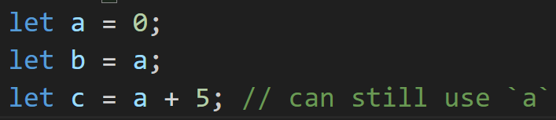
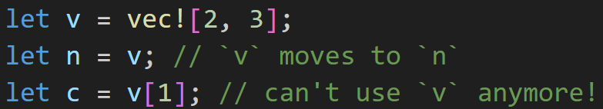
2. Variables
No longer usable!? What??
Rust has many useful quirks, this is one of them
For now, don’t panic, we’ll cover it when we get to the borrow checker
Primitive types are never moved, they are always copied
©Philippe Felix Haupt 2023

Slide 63
Intermission: How a program is run
Understanding how programs are run helps with writing better programs
©Philippe Felix Haupt 2023

Slide 64
Intermission: How a program is run
Understanding how programs are run helps with writing better programs
Computers process instructions sequentially
©Philippe Felix Haupt 2023

Slide 65
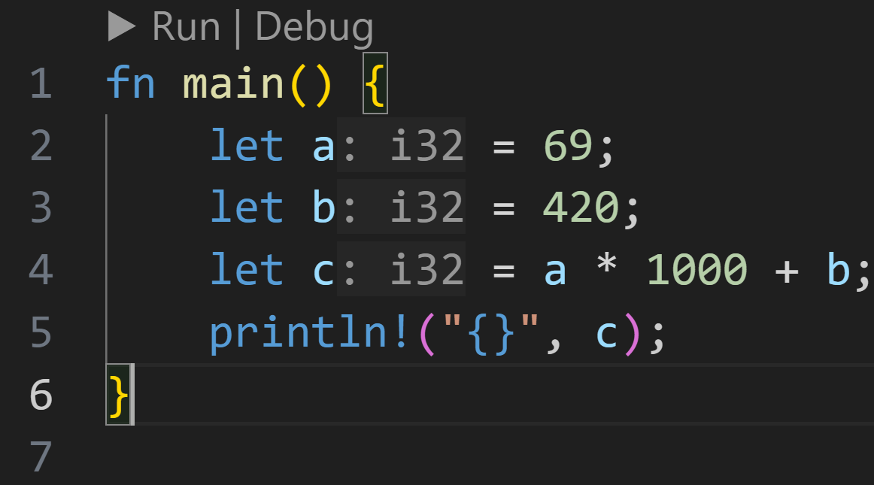
Intermission: How a program is run
Understanding how programs are run helps with writing better programs
Computers process instructions sequentially:
©Philippe Felix Haupt 2023

Slide 66
Intermission: How a program is run
Understanding how programs are run helps with writing better programs
Computers process instructions sequentially:
First: store 69 in `a`
©Philippe Felix Haupt 2023

Slide 67
Intermission: How a program is run
Understanding how programs are run helps with writing better programs
Computers process instructions sequentially:
First: store 69 in `a`
Then, store 420 in `b`
©Philippe Felix Haupt 2023

Slide 68
Intermission: How a program is run
Understanding how programs are run helps with writing better programs
Computers process instructions sequentially:
First: store 69 in `a`
Then, store 420 in `b`
Multiply `a` with 1000
©Philippe Felix Haupt 2023

Slide 69
Intermission: How a program is run
Understanding how programs are run helps with writing better programs
Computers process instructions sequentially:
First: store 69 in `a`
Then, store 420 in `b`
Add `b` to it, store the result in `c`
Multiply `a` with 1000
©Philippe Felix Haupt 2023

Slide 70
Intermission: How a program is run
Understanding how programs are run helps with writing better programs
Computers process instructions sequentially:
First: store 69 in `a`
Then, store 420 in `b`
Add `b` to it, store the result in `c`
Multiply `a` with 1000
Print the value of `c` to the console
©Philippe Felix Haupt 2023

Slide 71
Intermission: How a program is run
Understanding how programs are run helps with writing better programs
Computers process instructions sequentially
A `memory table` can help understand what the computer does
©Philippe Felix Haupt 2023

Slide 72
Intermission: How a program is run
Understanding how programs are run helps with writing better programs
Computers process instructions sequentially
A `memory table` can help understand what the computer does
Variable | Type | Value
©Philippe Felix Haupt 2023

Slide 73
Intermission: How a program is run
Understanding how programs are run helps with writing better programs
Computers process instructions sequentially
A `memory table` can help understand what the computer does
Variable | Type | Value
a | i32 | ???
b | i32 | ???
c | i32 | ???
temp* | i32 | ???
©Philippe Felix Haupt 2023

Slide 74
Intermission: How a program is run
Understanding how programs are run helps with writing better programs
Computers process instructions sequentially
A `memory table` can help understand what the computer does
Variable | Type | Value
a | i32 | 69
b | i32 | ???
c | i32 | ???
temp* | i32 | ???
©Philippe Felix Haupt 2023

Slide 75
Intermission: How a program is run
Understanding how programs are run helps with writing better programs
Computers process instructions sequentially
A `memory table` can help understand what the computer does
Variable | Type | Value
a | i32 | 69
b | i32 | 420
c | i32 | ???
temp* | i32 | ???
©Philippe Felix Haupt 2023

Slide 76
Intermission: How a program is run
Understanding how programs are run helps with writing better programs
Computers process instructions sequentially
A `memory table` can help understand what the computer does
Variable | Type | Value
a | i32 | 69
b | i32 | 420
c | i32 | ???
temp* | i32 | 69*1000=69000
©Philippe Felix Haupt 2023

Slide 77
Intermission: How a program is run
Understanding how programs are run helps with writing better programs
Computers process instructions sequentially
A `memory table` can help understand what the computer does
Variable | Type | Value
a | i32 | 69
b | i32 | 420
c | i32 | 69000+420=69420
temp* | i32 | 69000
©Philippe Felix Haupt 2023

Slide 78
Intermission: How a program is run
Understanding how programs are run helps with writing better programs
Computers process instructions sequentially
A `memory table` can help understand what the computer does
Variable | Type | Value
a | i32 | 69
b | i32 | 420
c | i32 | 69420
temp* | i32 | 69000
prints `69420`
©Philippe Felix Haupt 2023

Slide 79
Intermission: How a program is run
Understanding how programs are run helps with writing better programs
Computers process instructions sequentially
A `memory table` can help understand what the computer does
very helpful to create one for exercises that compile
go step by step through the program, do you get the same output as the computer?
©Philippe Felix Haupt 2023

Slide 80
Intermission: How a program is run
Understanding how programs are run helps with writing better programs
Computers process instructions sequentially
A `memory table` can help understand what the computer does
very helpful to create one for exercises that compile
go step by step through the program, do you get the same output as the computer?
Best debugging advice:
Go through your program, step by step, and pretend you’re the computer
if something doesn’t make sense to you, that’s usually where the bug is
©Philippe Felix Haupt 2023

Slide 81
Intermission: How a program is run
Understanding how programs are run helps with writing better programs
Computers process instructions sequentially
A `memory table` can help understand what the computer does
very helpful to create one for exercises that compile
go step by step through the program, do you get the same output as the computer?
Best debugging advice:
Go through your program, step by step, and pretend you’re the computer
if something doesn’t make sense to you, that’s usually where the bug is
https://en.wikipedia.org/wiki/Rubber_duck_debugging/
©Philippe Felix Haupt 2023

Slide 82
Intermission: How a program is run
Understanding how programs are run helps with writing better programs
Computers process instructions sequentially
A `memory table` can help understand what the computer does
very helpful to create one for exercises that compile
go step by step through the program, do you get the same output as the computer?
Best debugging advice:
Go through your program, step by step, and pretend you’re the computer
if something doesn’t make sense to you, that’s usually where the bug is
https://en.wikipedia.org/wiki/Rubber_duck_debugging/
Programming involves a lot of logic and reasoning
in theory → How computers work, how programming languages work
in practice → What I want my computer to do, and when, and how
©Philippe Felix Haupt 2023

Slide 83
Intermission: How a program is run
Understanding how programs are run helps with writing better programs
Computers process instructions sequentially
A `memory table` can help understand what the computer does
very helpful to create one for exercises that compile
go step by step through the program, do you get the same output as the computer?
Best debugging advice:
Go through your program, step by step, and pretend you’re the computer
if something doesn’t make sense to you, that’s usually where the bug is
https://en.wikipedia.org/wiki/Rubber_duck_debugging/
Programming involves a lot of logic and reasoning
in theory → How computers work, how programming languages work
in practice → What I want my computer to do, and when, and how
Better programming skills → better logical thinking and reasoning skills, and vice versa
©Philippe Felix Haupt 2023

Slide 84
Intermission: Exercise
Time for an exercise!
©Philippe Felix Haupt 2023

Slide 85
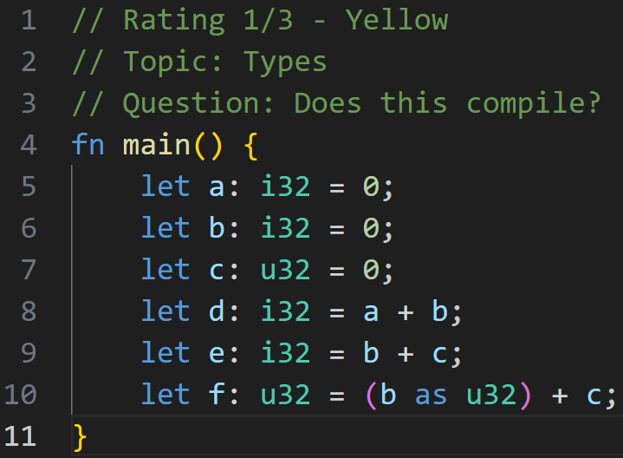
Intermission: Exercise
Time for an exercise!
1/3
©Philippe Felix Haupt 2023

Slide 86
Intermission: Exercise
Time for an exercise!
1/3
Nope! You can’t add i32 and u32 together!
©Philippe Felix Haupt 2023

Slide 87
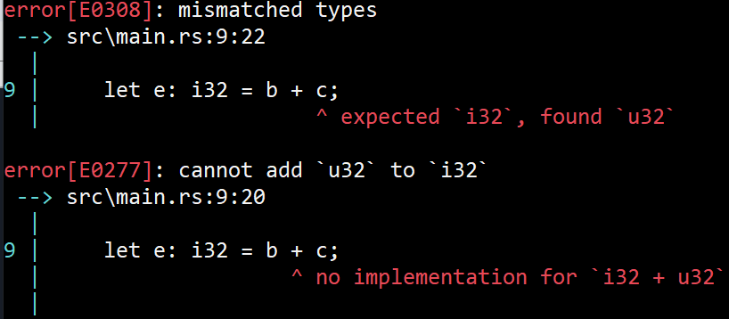
Intermission: Exercise
Time for an exercise!
1/3
Nope! You can’t add i32 and u32 together!
©Philippe Felix Haupt 2023

Slide 88
Intermission: Exercise
Time for an exercise!
1/3
Nope! You can’t add i32 and u32 together!
But Rust allows type casting
©Philippe Felix Haupt 2023

Slide 89
Intermission: Exercise
Time for an exercise!
1/3
Nope! You can’t add i32 and u32 together!
But Rust allows type casting
More about that later
©Philippe Felix Haupt 2023

Slide 90
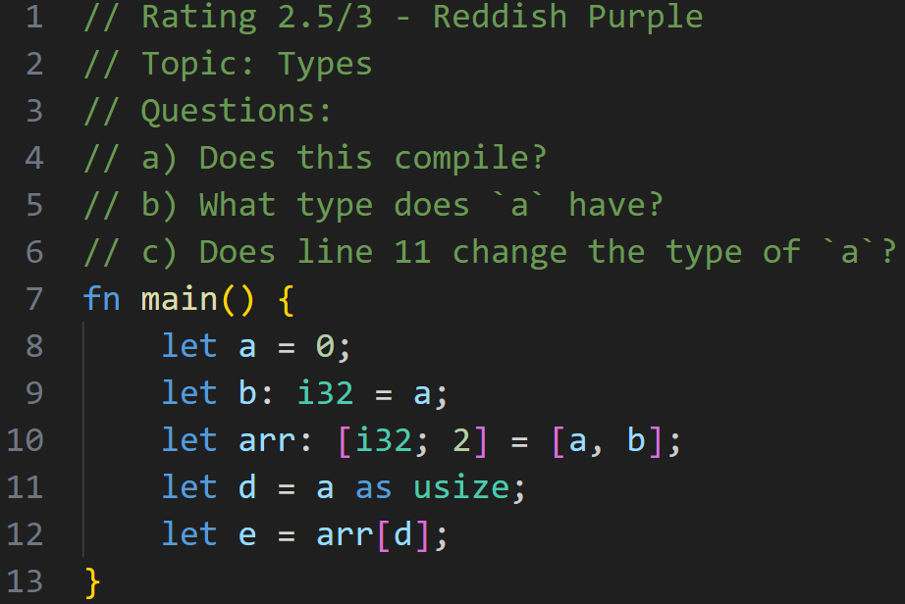
Intermission: Exercise
Time for an exercise!
2/3
©Philippe Felix Haupt 2023

Slide 91
Intermission: Exercise
Time for an exercise!
Yes! But how, we haven’t specified the type of all variables! → Coming next
2/3
©Philippe Felix Haupt 2023

Slide 92
Intermission: Exercise
Time for an exercise!
Yes! But how, we haven’t specified the type of all variables! → Coming next
2/3
Type Inference, because we assign `a` to `b`, `a` must also be `i32` (also confirmed because `a` is part of `i32`-array)
©Philippe Felix Haupt 2023

Slide 93
Intermission: Exercise
Time for an exercise!
Yes! But how, we haven’t specified the type of all variables! → Coming next
2/3
Type Inference, because we assign `a` to `b`, `a` must also be `i32` (also confirmed because `a` is part of `i32`-array)
No, it doesn’t. It casts the value of `a` to `usize`, not `a` itself.
©Philippe Felix Haupt 2023

Slide 94
Intermission: Exercise
Time for an exercise!
Yes! But how, we haven’t specified the type of all variables! → Coming next
2/3
Type Inference, because we assign `a` to `b`, `a` must also be `i32` (also confirmed because `a` is part of `i32`-array)
No, it doesn’t. It casts the value of `a` to `usize`, not `a` itself.
Out-of-bounds checking is done at runtime (what if `d` was 7?)
©Philippe Felix Haupt 2023

Slide 95
2. Variables - Type Inference
©Philippe Felix Haupt 2023

Slide 96
2. Variables - Type Inference
The Rust compiler is very smart, it can figure out types of variables on its own
©Philippe Felix Haupt 2023

Slide 97
2. Variables - Type Inference
The Rust compiler is very smart, it can figure out types of variables on its own
In 95% of the cases you can omit the type declaration, and it will just work fine
©Philippe Felix Haupt 2023

Slide 98
2. Variables - Type Inference
The Rust compiler is very smart, it can figure out types of variables on its own
In 95% of the cases you can omit the type declaration, and it will just work fine
rust-analyzer is super helpful here:
©Philippe Felix Haupt 2023

Slide 99
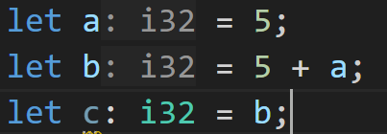
2. Variables - Type Inference
The Rust compiler is very smart, it can figure out types of variables on its own
In 95% of the cases you can omit the type declaration, and it will just work fine
rust-analyzer is super helpful here:
`a` and `b` are inferred to be `i32`, which rust-analyzer shows here
©Philippe Felix Haupt 2023

Slide 100
2. Variables - Type Inference
The Rust compiler is very smart, it can figure out types of variables on its own
In 95% of the cases you can omit the type declaration, and it will just work fine
rust-analyzer is super helpful here:
Saves a lot of typing in bigger codebases
`a` and `b` are inferred to be `i32`, which rust-analyzer shows here
©Philippe Felix Haupt 2023

Slide 101
2. Variables - Type Inference
The Rust compiler is very smart, it can figure out types of variables on its own
In 95% of the cases you can omit the type declaration, and it will just work fine
rust-analyzer is super helpful here:
Saves a lot of typing in bigger codebases
How does it work?
`a` and `b` are inferred to be `i32`, which rust-analyzer shows here
2/3
©Philippe Felix Haupt 2023

Slide 102
2. Variables - Type Inference
The Rust compiler is very smart, it can figure out types of variables on its own
In 95% of the cases you can omit the type declaration, and it will just work fine
rust-analyzer is super helpful here:
Saves a lot of typing in bigger codebases
How does it work?
The first time it finds a type in the context of `a`, it assigns that type to `a`
`a` and `b` are inferred to be `i32`, which rust-analyzer shows here
2/3
©Philippe Felix Haupt 2023

Slide 103
2. Variables - Type Inference
The Rust compiler is very smart, it can figure out types of variables on its own
In 95% of the cases you can omit the type declaration, and it will just work fine
rust-analyzer is super helpful here:
Saves a lot of typing in bigger codebases
How does it work?
The first time it finds a type in the context of `a`, it assigns that type to `a`
c = i32 → b = i32 ← line 3
`a` and `b` are inferred to be `i32`, which rust-analyzer shows here
2/3
©Philippe Felix Haupt 2023

Slide 104
2. Variables - Type Inference
The Rust compiler is very smart, it can figure out types of variables on its own
In 95% of the cases you can omit the type declaration, and it will just work fine
rust-analyzer is super helpful here:
Saves a lot of typing in bigger codebases
How does it work?
The first time it finds a type in the context of `a`, it assigns that type to `a`
c = i32 → b = i32 ← line 3
b = i32 → a = i32 ← line 2
`a` and `b` are inferred to be `i32`, which rust-analyzer shows here
2/3
©Philippe Felix Haupt 2023

Slide 105
2. Variables - Type Inference
The Rust compiler is very smart, it can figure out types of variables on its own
In 95% of the cases you can omit the type declaration, and it will just work fine
rust-analyzer is super helpful here:
Saves a lot of typing in bigger codebases
How does it work?
The first time it finds a type in the context of `a`, it assigns that type to `a`
c = i32 → b = i32 ← line 3
b = i32 → a = i32 ← line 2
That first time could even be 50 lines away, and it would still figure it out
`a` and `b` are inferred to be `i32`, which rust-analyzer shows here
2/3
©Philippe Felix Haupt 2023

Slide 106
2. Variables - Type Inference
Usual type checking rules apply after it inferred a type
©Philippe Felix Haupt 2023

Slide 107
2. Variables - Type Inference
Usual type checking rules apply after it inferred a type
If it fails to infer a type, the compiler will tell you to please annotate the variable
©Philippe Felix Haupt 2023

Slide 108
2. Variables - Type Inference
Usual type checking rules apply after it inferred a type
If it fails to infer a type, the compiler will tell you to please annotate the variable
Mostly the case when chaining function calls, like `vec.iter().map().filter().collect()`
©Philippe Felix Haupt 2023

Slide 109
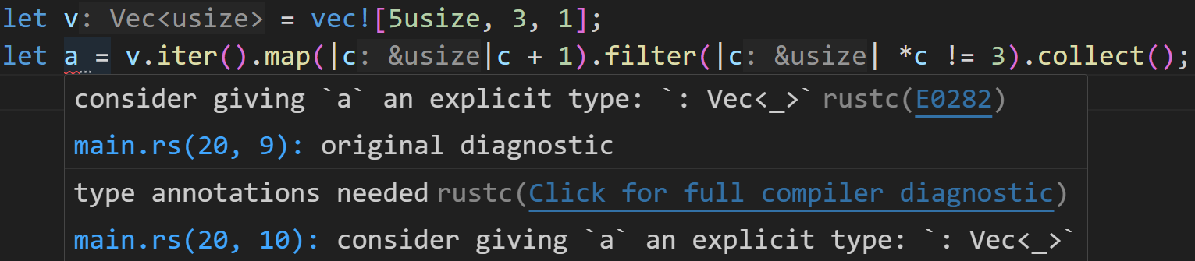
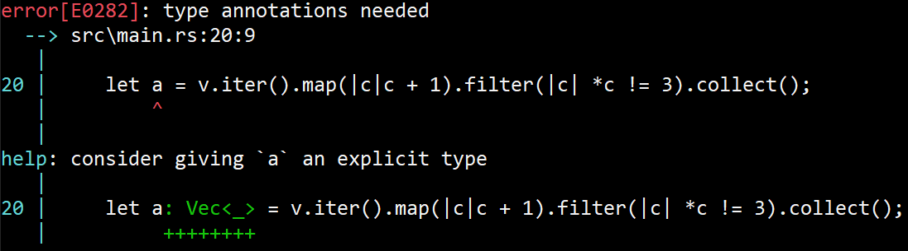
2. Variables - Type Inference
Usual type checking rules apply after it inferred a type
If it fails to infer a type, the compiler will tell you to please annotate the variable
Mostly the case when chaining function calls, like `vec.iter().map().filter().collect()`
May look like this:
©Philippe Felix Haupt 2023

Slide 110
2. Variables - Type Inference
Usual type checking rules apply after it inferred a type
If it fails to infer a type, the compiler will tell you to please annotate the variable
Mostly the case when chaining function calls, like `vec.iter().map().filter().collect()`
May look like this:
Was able to infer the type of `v`
©Philippe Felix Haupt 2023

Slide 111
2. Variables - Type Inference
For now, my examples will still use explicit types, but I’ll soon switch to Type Inference
©Philippe Felix Haupt 2023

Slide 112
2. Variables - Type Inference
For now, my examples will still use explicit types, but I’ll soon switch to Type Inference
For the exercises I recommend disabling the rust-analyzer, otherwise it spoils the answer :^)
©Philippe Felix Haupt 2023

Slide 113
2. Variables - Type Inference
For now, my examples will still use explicit types, but I’ll soon switch to Type Inference
For the exercises I recommend disabling the rust-analyzer, otherwise it spoils the answer :^)
More examples and exercises will follow soon
©Philippe Felix Haupt 2023

Slide 114
3. Next time
Arrays
Vectors
Why moving is sometimes better than copying
and what to do if we want to copy anyway
©Philippe Felix Haupt 2023

Slide 115
3. Next time
Arrays
Vectors
Why moving is sometimes better than copying
and what to do if we want to copy anyway
Until then:
for each session starting with this one, there’s a file called exercises.md in that folder, for you to learn and repeat what we covered so far
Github can render Markdown-files on their website
Visual Studio Code can render them too → Right Click → Open Preview
©Philippe Felix Haupt 2023

Slide 116
3. Next time
Arrays
Vectors
Why moving is sometimes better than copying
and what to do if we want to copy anyway
Until then:
for each session starting with this one, there’s a file called exercises.md in that folder, for you to learn and repeat what we covered so far
Github can render Markdown-files on their website
Visual Studio Code can render them too → Right Click → Open Preview
in the beginning of every session, we will compare the results of the exercises and cover all remaining questions
©Philippe Felix Haupt 2023

